Slide 1


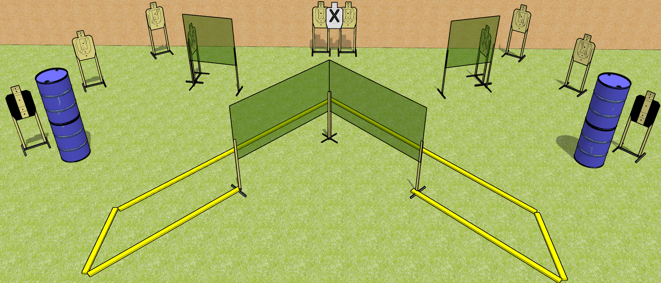
 | Dothan Gun Club – USPSA Match Shoot all the Things! Course Designer : Drew Coleman
START POSITION : Standing straddling the leftmost or right most fault line, wrists above shoulders.
GUN READY CONDITION : Pistol loaded and holstered. PCC loaded, buttstock on belt, safety on, muzzle perpendicular to the back berm. |  | SCORING: Comstock, 30 rounds TARGETS: 10 paper, 0 Steel SCORED HITS: Best 3 on paper, steel until down START-STOP: Audible, last shot RULES:
STAGE PROCEDURE: Engage targets as they become available from within the fault lines.

Slide 2
Shoot All the Things!
Written Stage Briefing
Shoot all the Things! is a 30 round, 150 point, Comstock field courses. There are ten USPSA targets. The best three hits on paper will score. The start signal is audible.
Handgun start position is standing straddling the leftmost or rightmost fault line with wrists above respective shoulders. Handgun is loaded and holstered.
PCC start position is standing straddling the leftmost or rightmost fault line, muzzle perpendicular to the back berm. Loaded carbine is held with both hands, safety on, buttstock on belt.
Upon start signal, engage targets as they become available from within the fault lines.

